Slide 1
Google Migration
Meera Nair
Megan Clark
ITS Identity and Access Management
November 6, 2023
Notes:
We're here to talk about the upcoming migration from Google workspace to Microsoft 365.
We'll start with why we're making the change, explain how the migration will work, provide our current rough timeline, and in the end ideally even have a few minutes to field questions.
Both

Slide 2
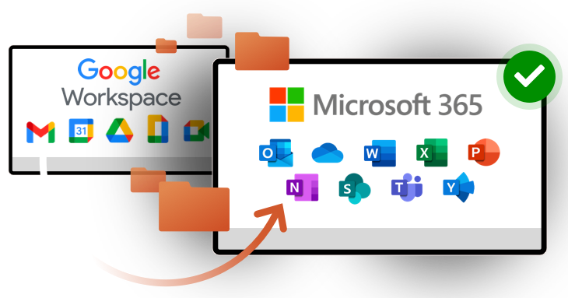
Why this change?
Notes:
Google unilaterally updated their terms and conditions, moving to a fee-based storage model instead of their prior offering of free and unlimited storage for educational institutions
In addition to this adding cost, maintaining a Google environment has meant maintaining and supporting two simultaneous communication and collaboration platforms
With this project, we're moving to a unified experience for faculty, staff, and students
Now all community members can collaborate within one feature-rich platform
Plus students will gain experience with the applications used most frequently by future employers
Megan

Slide 3
Who will be impacted?
Active Students | Data will be migrated to Outlook and OneDrive Emails will be directed to Outlook, not Gmail
Faculty and Staff | Data will be migrated to OneDrive or SharePoint
Alumni | Must back up or move data by April 2024 Email forwarding service will be available to opt into Accounts will be deleted from Google
Notes:
Meera

Slide 4
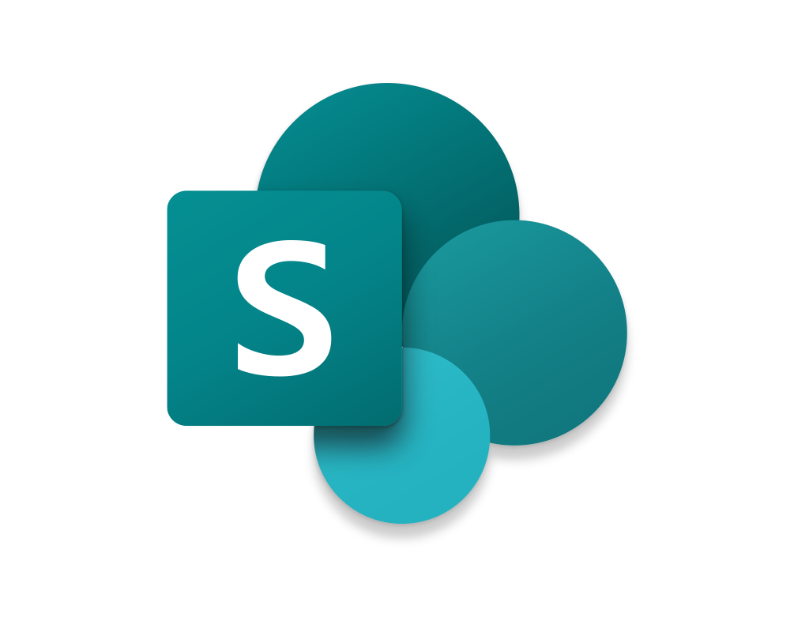
OneDrive and SharePoint
OneDrive
Individual storage
Connected to user account
Supervisor gets access for 90 days when user account is deleted
Data is permanently deleted after 90 days
SharePoint
Departmental storage
Documents remain even after owner account is deleted
Notes:
Before we continue, let's use this opportunity for a brief review of the difference between OneDrive and SharePoint.
Owner of file drops even tho shared, file gets deleted
Meera

Slide 5
OneDrive and SharePoint
Both services offer:
Version history
Full encryption in transit and at rest
Two stages of Recycling Bin
Audit logging
Sharing outside of UConn
Notes:
Meera

Slide 6
What will and will not migrate?
Will Migrate:
Email
Calendar
Contacts
Tasks
Drive
Forms*
Structure/Organization
Will Not Migrate:
Drawings
Sites
Photos
Maps
Files larger than 15 GB
Sharing/Permissions
Other options are available to preserve these files.
Notes:
Microsoft has provided us with tools that we can use to export data from Google, convert those files into Microsoft-compatible versions if applicable, then import the new data into Microsoft, preserving as much metadata, folder structure, and labelling as possible.
Google Starred emails will be migrated as Flagged in Exchange because Exchange does not have an equivalent to Stars
Labels are converted to folders- Mails are stored to the folders corresponding to the labels.
Google Photos =/= photo on Google Drive
Megan

Slide 7
Google Drive Migration
Data can be migrated to OneDrive (personal data) or SharePoint Online (departmental data)
Permissions will not be migrated
Files will ONLY migrate if owned by an active UConn user
Files "Shared with me" owned by alumni? Transfer ownership or make a copy to your Drive
Notes:
Megan

Slide 8
Accessing External Google Data
Data shared to UConn users can be accessed after:
UConn user creates an unmanaged account in Google
Data owner re-shares access to new unmanaged account
Do not store UConn data in unmanaged accounts
Unmanaged Google account: A Google login using an @uconn.edu address as the username which is not managed by UConn IT.
Notes:
One of the most frequent questions we've gotten since announcing the change is: What if I use Google to collaborate with external users, either on files they own or UConn-owned data? None of this will be interrupted!
If the data is owned by another organization, it will not be impacted by our migration.
SharePoint and OneDrive also allow for collaboration with external participants, though the setting may need to be enabled by ITS on individual SharePoint sites.
Make sure not to save University data in that .
Meera

Slide 9
Hiccups…
Shared files must be re-shared after migration
Hyperlinks to other migrated documents will not be automatically rewritten
Hyperlinks within documents will continue to work
Hyperlinks to external resources (e.g., web sites) will continue to work
Files over 15 GB will not be moved automatically
File paths must be fewer than 400 characters
Notes:
Megan

Slide 10
When is this happening?
Fall 2023:
Early adopters migrate
(ongoing)
April 2024:
Alumni accounts removed
January 2024: New student accounts on M365
December 2023:
Storage limits for students
Spring 2024:
Migrate staff drive data
Summer 2024: Final Migration (students and faculty)
Notes:
Students already have access to M365 services.
All new student accounts on 365 in Jan 2024
Migrating staff drive data in Spring 2024
Summer 2024: Faculty & students
Meera

Slide 11
What can I do now?
Clean up your data:
Delete what you don't need
Take ownership of what you do need
Move personal data to a personal account
Help your users with their own data
Interested in migrating drive data early?
Contact us! (Information in next slide)
Notes:
Take ownership of what you do need: As alumni accounts close, their data will be moved or deleted. If you have folders of research that are owned by former students you worked with, make sure you move a copy into your own Drive
IT can provide assistance to users to clean up files and prep and communicate with them
Meera

Slide 12
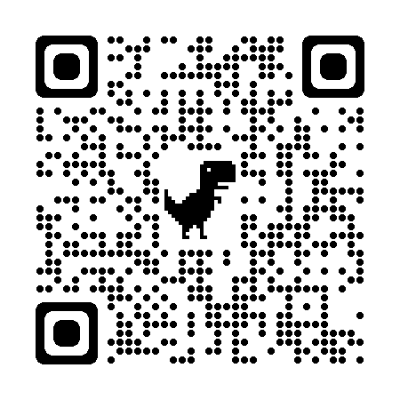
For More Information
https://s.uconn.edu/googleto365
Email: | techsupport@uconn.edu
Online: | techsupport.uconn.edu
Phone: | 860-486-4357
Notes:
I cannot answer all your questions at this point..
For additional questions, or to opt into an early data migration, contact the TSC to open a ticket

